Slide 1

Power BI Project
Hospitality Domain
Created by: Neha Khanna

Slide 2
Project Objective
To develop a comprehensive weekly dashboard for AtliQ Grands that provides real-time insights into key performance metrics and trends, enabling stakeholders to monitor and analyze their revenue effectively.

Slide 3

Import data to Power BI
1. Connect to data source
2. Import csv file into Power BI

Slide 4
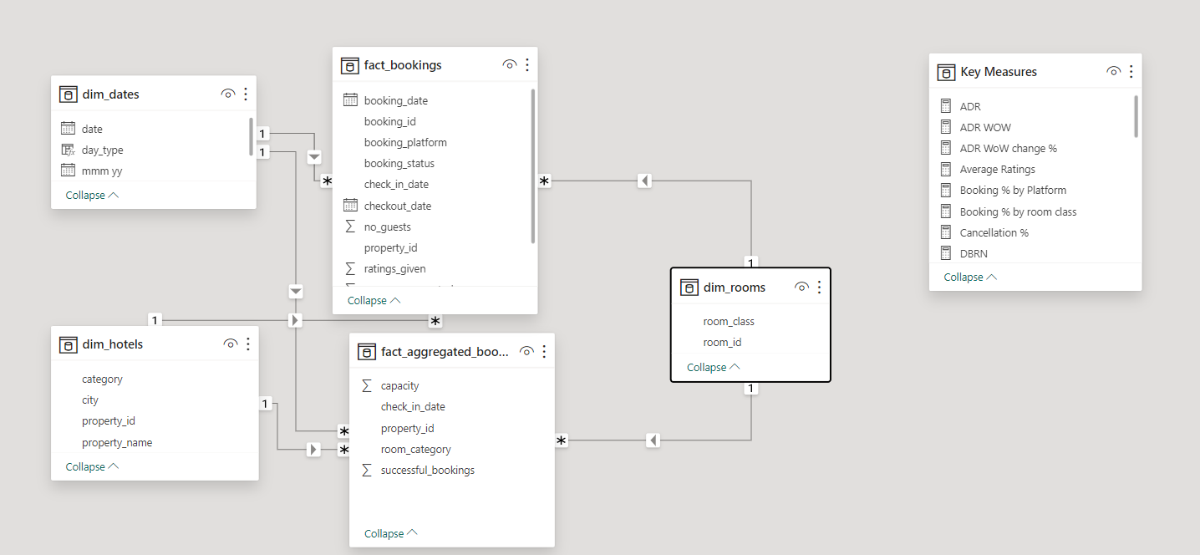
Data Model- Snowflake Schema

Slide 5
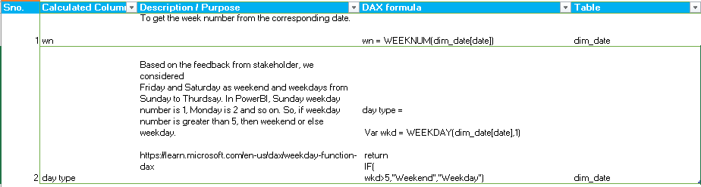
Calculated Column

Slide 6
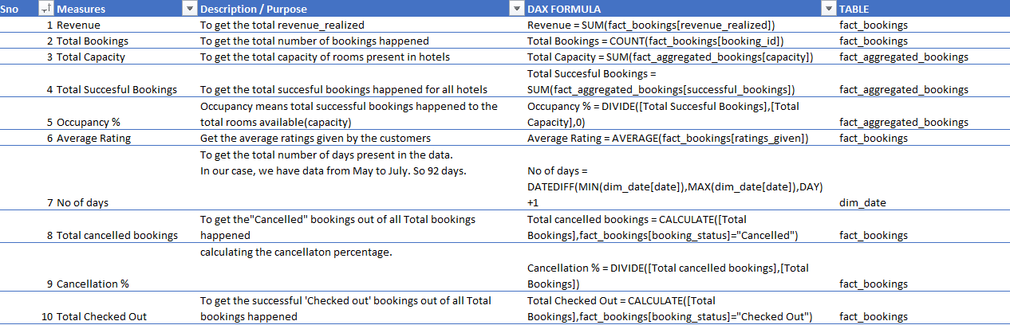
DAX measures

Slide 7
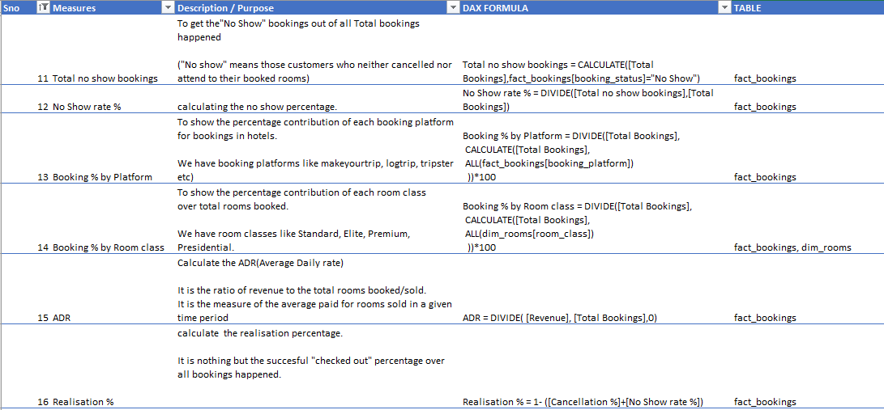
DAX measures

Slide 8
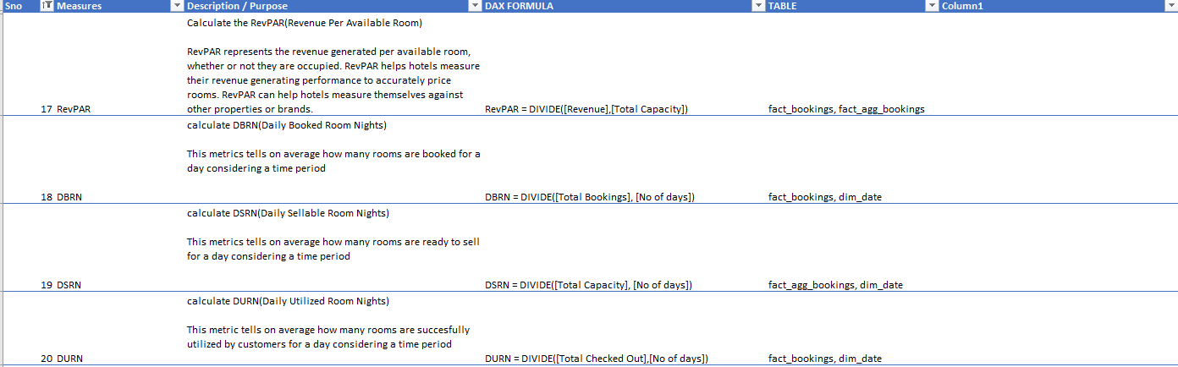
DAX measures

Slide 9
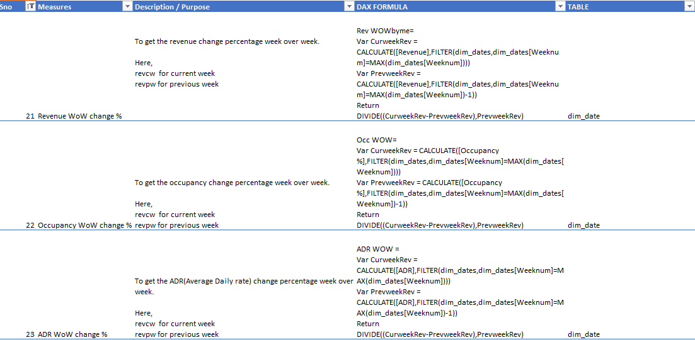
DAX measures

Slide 10
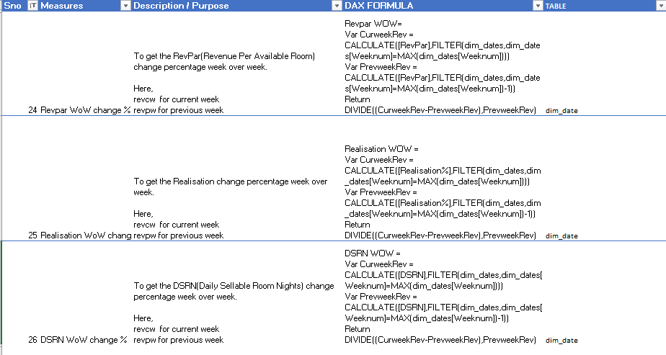
DAX measures

Slide 11
Project Insights
Overall revenue generated on weekdays is $1B and weekend is $524M
Mumbai has generated the highest revenue(660.6M) followed by Bangalore, Hyderabad and Delhi
Delhi has the highest occupancy of 60.55% and average rating of 3.8
AtliQ bay has the highest number of Occupancy rate(66%)
AtliQ Exotica performs better compared to all other types of properties with 320M revenue, average rating of 3.62, occupancy at 57.26% and Cancellation rate at 17.42%.
AtliQ has lost around $ 199M due to cancellation
Elite type rooms has highest number bookings as well as cancellation rate

